Slide 1

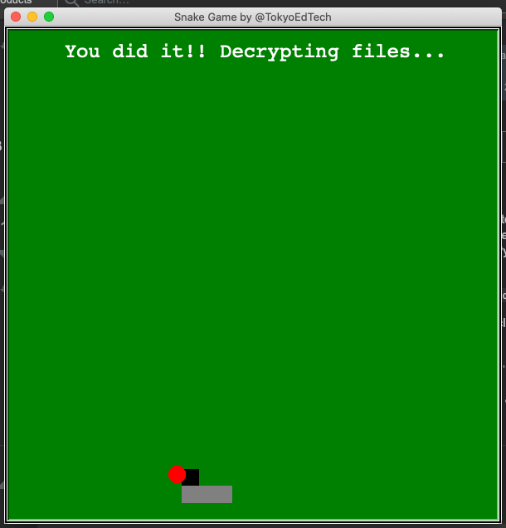
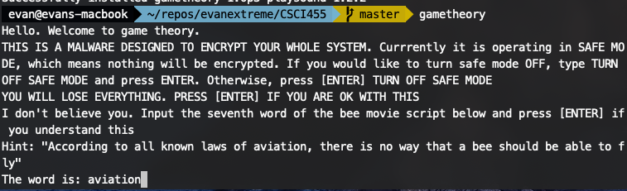
Constructing Malicious Ransomware In Python
B. THOMAS GOLISANO COLLEGE OF COMPUTING & INFORMATION SCIENCES
Aidan Rubenstein ar2126@rit.edu Andrew Giannone atg5232@rit.edu
Evan Hirsh exh7928@rit.edu ■ ■ ■ Advisor: Dr. Rajendra K. Raj rkr@cs.rit.edu
Introduction
Our Program
Results
Popularity of ransomware has increased drastically
Responsible for some of the largest attacks and loss of capital globally by malware
This study is motivated to build, test, and observe ransomware so that it can be better understood and mitigated
We built a simple ransomware in python using easily available resources, packaged into an executable, and targeting Windows machines.
We do not want the executable to be used maliciously for actual ransomware purposes
To solve this, it does not encrypt data by default, and asks consent from the user.
System Design
Before After
Before: A clean uncompromised Windows Sandbox environment.
After: A fully encrypted user directory, compromising even the desktop images.
Ransomware
Detects the home directory on Windows, and encrypts all files
Decrypts the files only if the user scores 3 points in a game of snake
Downloaded and executed via malicious VBA Office macro
Utilizes the python cryptography library to implement AES
Utilizes a modified open source snake game written in python
Future Work
Parallelizing Encryption
Ransomware is a type of malware that renders users' files inaccessible by encrypting them with a key known only to the attacker.
In most cases, a ransom in the form of cryptocurrency is demanded by the malicious actor, hence the term ransomware [1]
In 2019, the average payment requested to release les from ransomware was $84,116. This has been steadily increasing.
the notable ”WannaCry” ransomware affected businesses and users in over 150 countries and cost an estimated $4 billion in financial losses [6]
Encryption / Decryption runs serially
Each file can be edited using a thread in a map pool
Circumventing Security
Our program and macro was detected by the system at multiple points. This can potentially be improved.
Chrome, Edge, and Windows Defender all saw the EXE as malicious.
Office parses macros and flags any that download/execute payloads
Summary
Implementation
Filesystem Encryption
We determined that a ransomware is easy to implement in most languages
Modern copies of Windows by default does an excellent job of detecting ransomware, but older versions deployed in enterprises do not.
To protect these systems, it is imperative that files are backed up routinely and securely in offside or cloud locations.
Phishing Email
WannaCry Ransomware
Word Doc
Ransomware EXE
The Phish
References
U.S. Cybersecurity and Infrastructure Security Agency. 2019. Ransomware.(2019). https://www.us-cert.gov/Ransomware
Kaspersky Lab. 2018. What are the different types of ransomware? (2018). https://www.kaspersky.co.uk/resource-center/threats/ransomware-examples
We created a phishing email which includes a word doc with a macro that downloads our ransomware exe
Looks completely innocuous, can be sent from any compromised account
Not flagged as spam

